Slide 1
10 – Clean Code – Open Close Principle (OCP)
Based on the CleanCoders videos by Uncle Bob Martin
Rupert Waldron

Slide 2
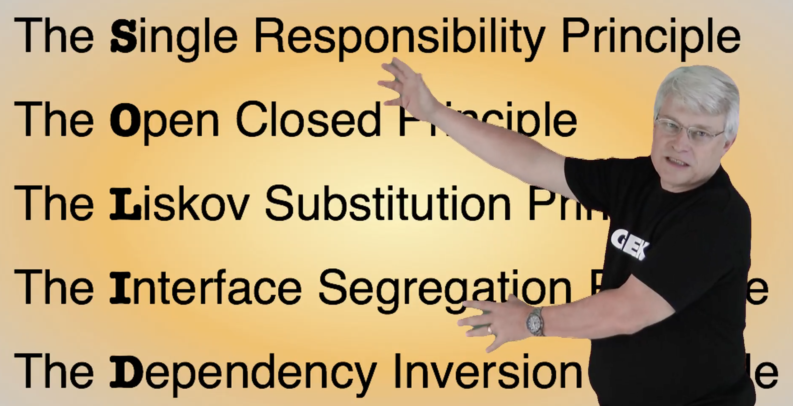
Object Orientated Design is all about Dependency Management
Uncle Bob gives us these dependency management principles that control operations and relationships between classes

Slide 3
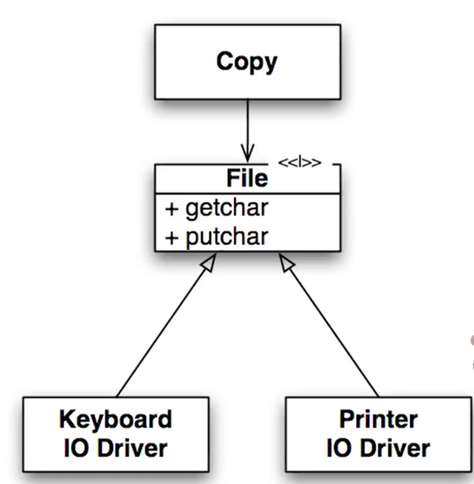
Open Close Principle
OCP means you should be able to change the behaviour of a module but without changing the source code. A good example is the copy module which uses an interface so the copy module no long depends on input and output devices.
To make an OCP module extract the external dependencies and insert an abstract interface which will invert the dependencies. The Copy module now only depends on the new file abstraction.
Flow of Control
We can change the lower level modules without even recompiling the Copy module – we can add new devices without changing the copy module
If you design your system according to the open close principle then you can modify your system by adding new code, and not changing the existing code.

Slide 4
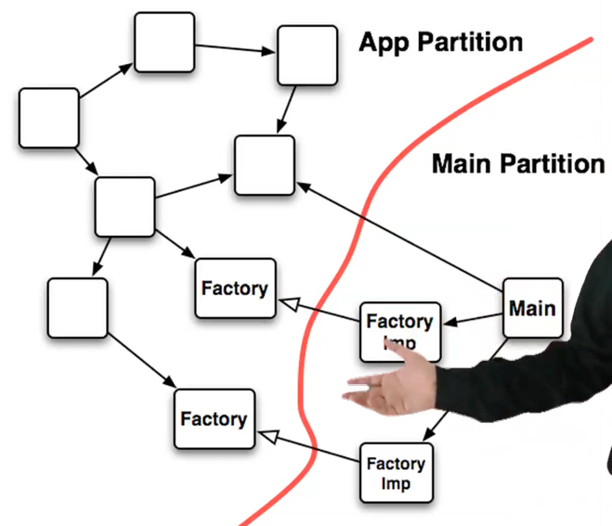
The problem of main()
All dependencies should point away from main across a boundary, and therefore can’t comply with the open close principle. Can use dependency injection frameworks – help.
OCP is much easier to do for smaller classes and functions, much harder for a larger system

Slide 5
Expense Report example
Look at the tests to see that the application does.
The tests test the business login through the user interface (printout) – SRP violation
The smelly code mixes business rules with formatting in the same function – lots of SRP violations.
But there is something much more insidious hidden in the code….
Try changing the messaging and formatting
Try updating the business rules
Try adding a new expense type

Slide 6
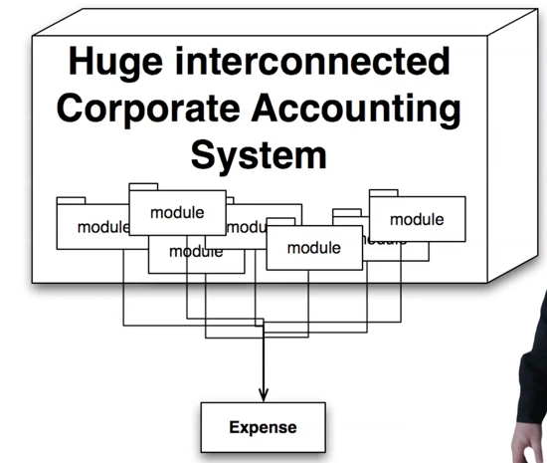
Expense Report example cont
The first module that needs to be changed if you add a new meal type is the Expense class. Every single module that depends on the expense type will need to be recompiled.
Rigidity – The design change is small but the impact is huge – the system resists change.
Fragility – The Expense Enum will be used throughout. If we did add the lunch Enum we would have to go through the whole system updating if else and switch statements. The code is fragile. This is the worst design smell because the customers and managers come to the conclusion that developers have lost control of the software.

Slide 7
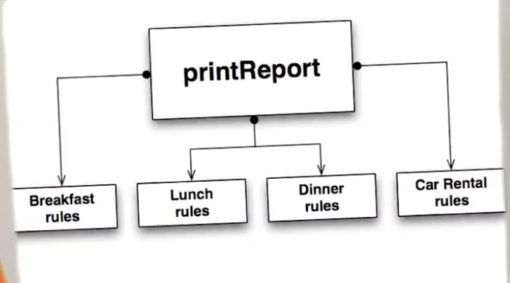
Expense Report cont…
Consider the company wants to change the software model to giveaway the core and then sell difference expense plugins. This would require the software being broken up into components.
Immobility - Note this is bad because the arrows say that the printReport contains all the Expense functionality so can’t be deployed separately. At the moment deploying this system is an all or nothing proposition

Slide 8
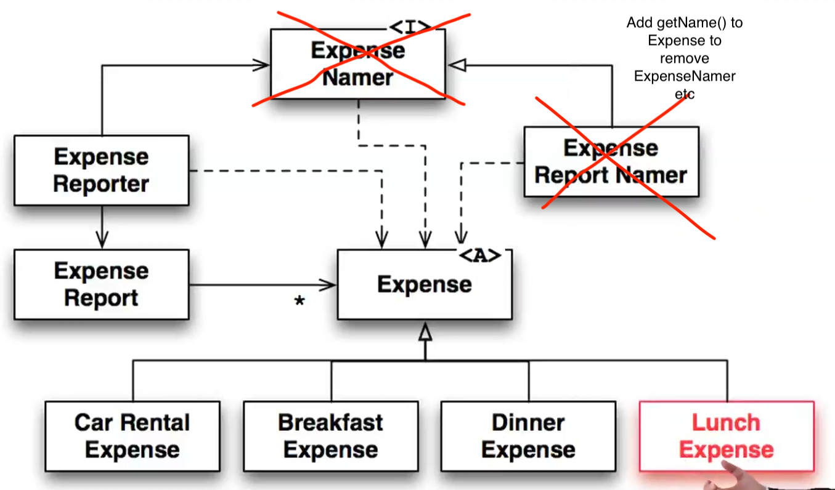

Expense Report – how it should be written
Take a look at the new code
Boundary
How easy is it to add a lunch expense class?
Parts of the system that are open to modification live on one side of the boundary.
The design is now also mobile as the plugins are on one side of the boundary.

Slide 9
Expense Report – All great… ?
Now how easy is it to put a * next to any expense that occurs at the weekend?
Solution 1 – Big Design Up Front (BDUF) - anticipating customers needs.
However, you normally end up with a large number of abstractions that are mostly unnecessary.
The code is often hard to follow.
The cost of maintaining the code goes up.
Solution 2 – Agile Design. Do the simplest design you possibly can and get it out in front of the customer.
The changes that result from interaction with the customer are probably also likely to change in the future, so you can protect yourself against those changes.
Solution 3 – Somewhere in the middle – small well abstracted domain model upfront and then follow the agile approach of solution 2.

